Slide 1




Team Big Short !

Slide 2
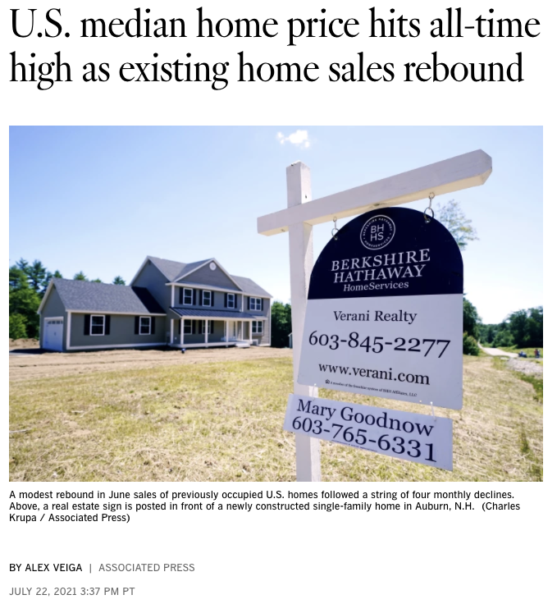

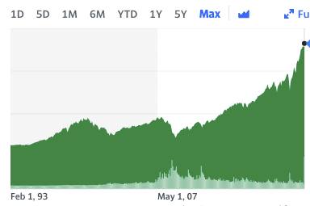

Slide 3
Train a machine learning model on a range of features to accurately predict when to buy/sell the iShares US Real Estate ETF.
Notes:
Good to trade b/c of volatility coming up in the housing market

Slide 4
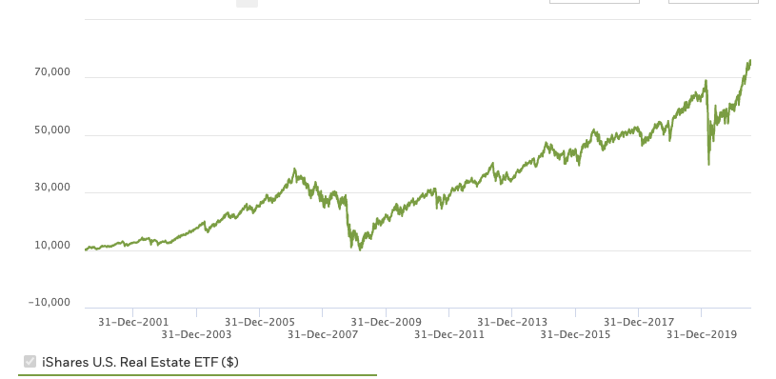
iShares U.S. Real Estate ETF (IYR)
ETF
Exposure to U.S. real estate companies and REITs
Inception date June ‘00
Daily data

Slide 5
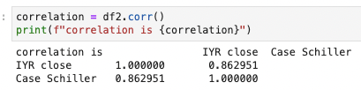
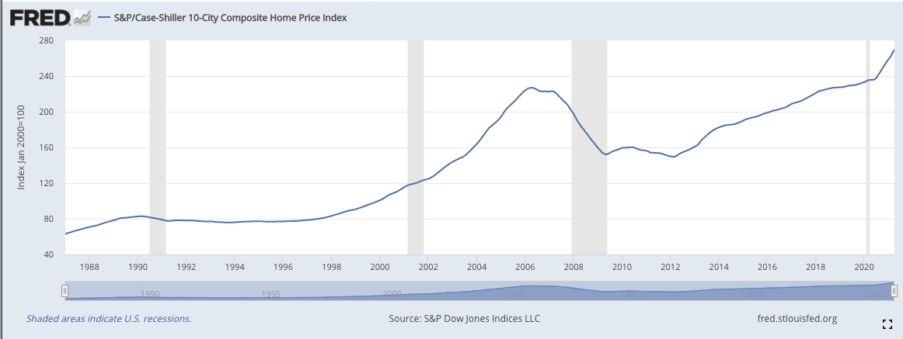
Case-Schiller Composite Home Price
86% correlation with IYR
Quarterly data
Inception date January ‘87

Slide 6
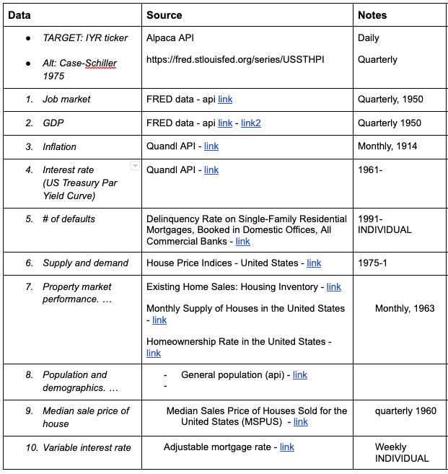
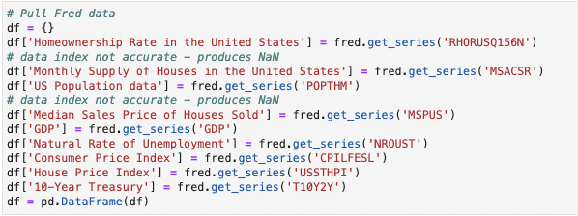
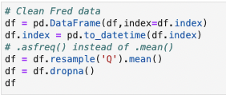
Features

Slide 7
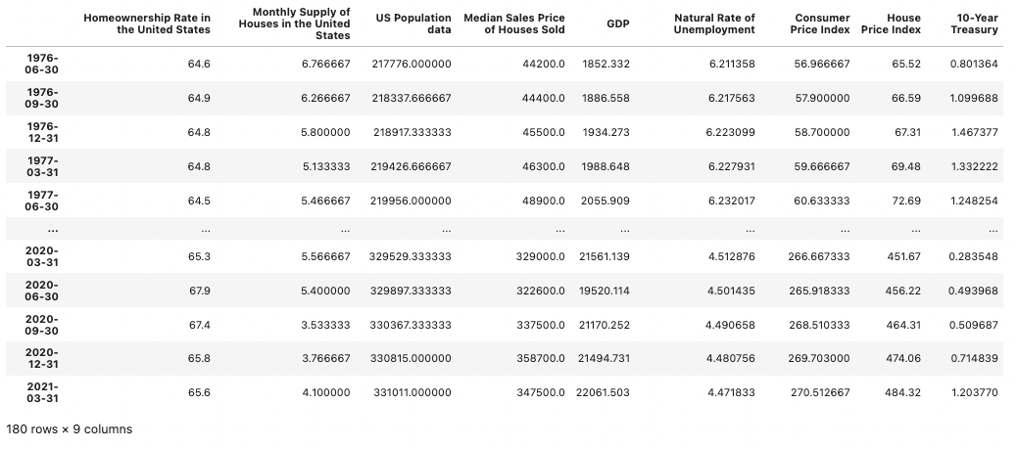
Features

Slide 8
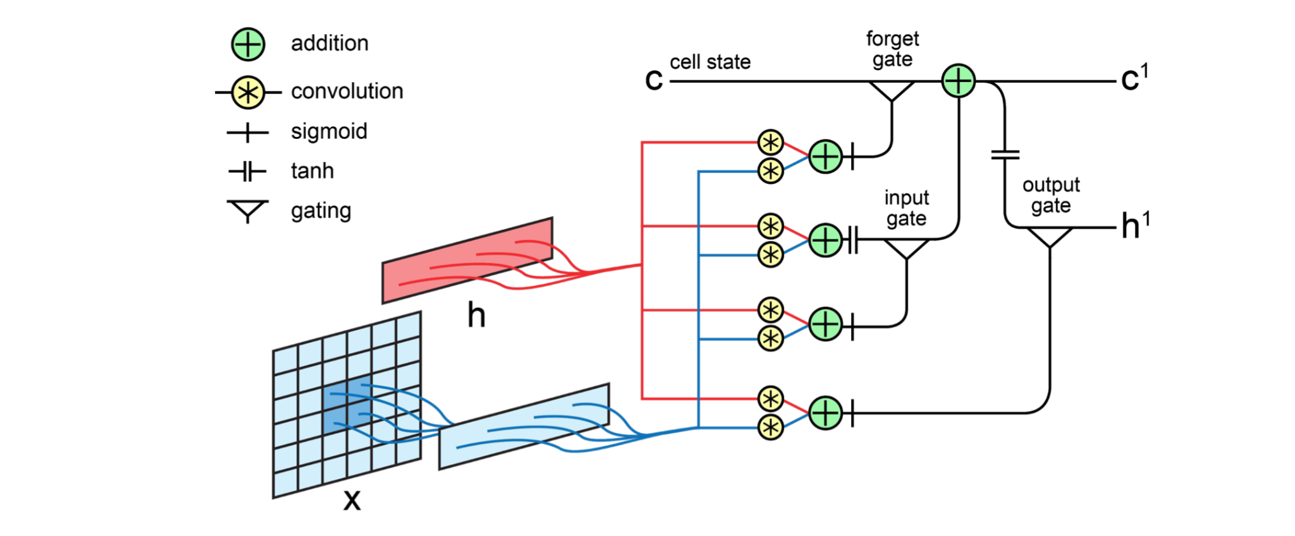
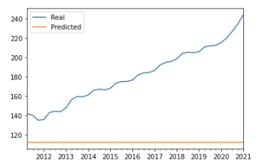
Long short-term memory (LSTM)
Recurrent neural network
Pro’s
Selective memory
Good for longer time windows
Cons
Long to train (+ 35k epochs)
Sensitive to manipulations
Result
Poor predictions of Case Shiller and therefore IYR

Slide 9

Long short-term memory (LSTM)
Recurrent neural network
Pro’s
Selective memory
Good for longer time windows
Cons
Long to train (+ 35k epochs)
Sensitive to manipulations
Result
Poor predictions of Case Shiller and therefore IYR

Slide 10
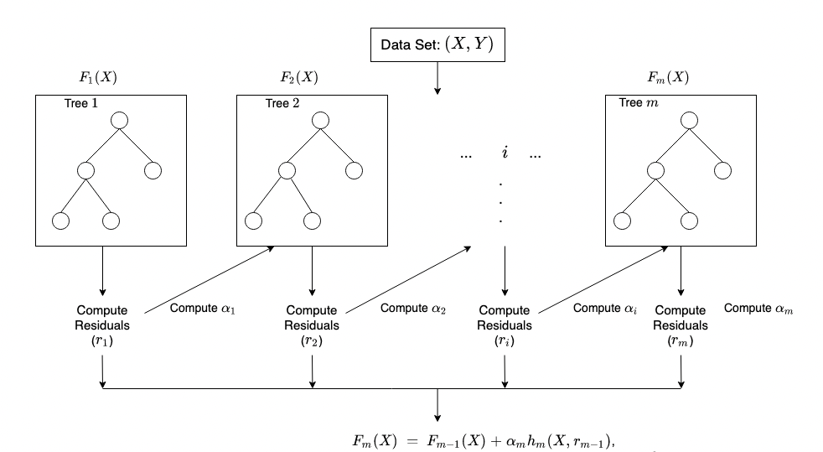
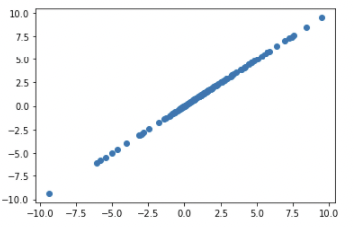
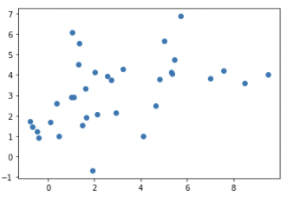
XG Boost
Gradient Boosting Machine Learning
Pro’s
Speed & performance
Good for numeric values
Combine the estimates of a set of simpler, weaker models.
Cons
Overfitting
Result
Potential, however more fine tuning required
Notes:
Gradient boosting is a supervised learning algorithm, which attempts to accurately predict a target variable by combining the estimates of a set of simpler, weaker models.

Slide 11

XG Boost
Gradient Boosting Machine Learning
Pro’s
Speed & performance
Good for numeric values
Combine the estimates of a set of simpler, weaker models.
Cons
Overfitting
Result
Potential, however more fine tuning required
Notes:
Gradient boosting is a supervised learning algorithm, which attempts to accurately predict a target variable by combining the estimates of a set of simpler, weaker models.

Slide 12
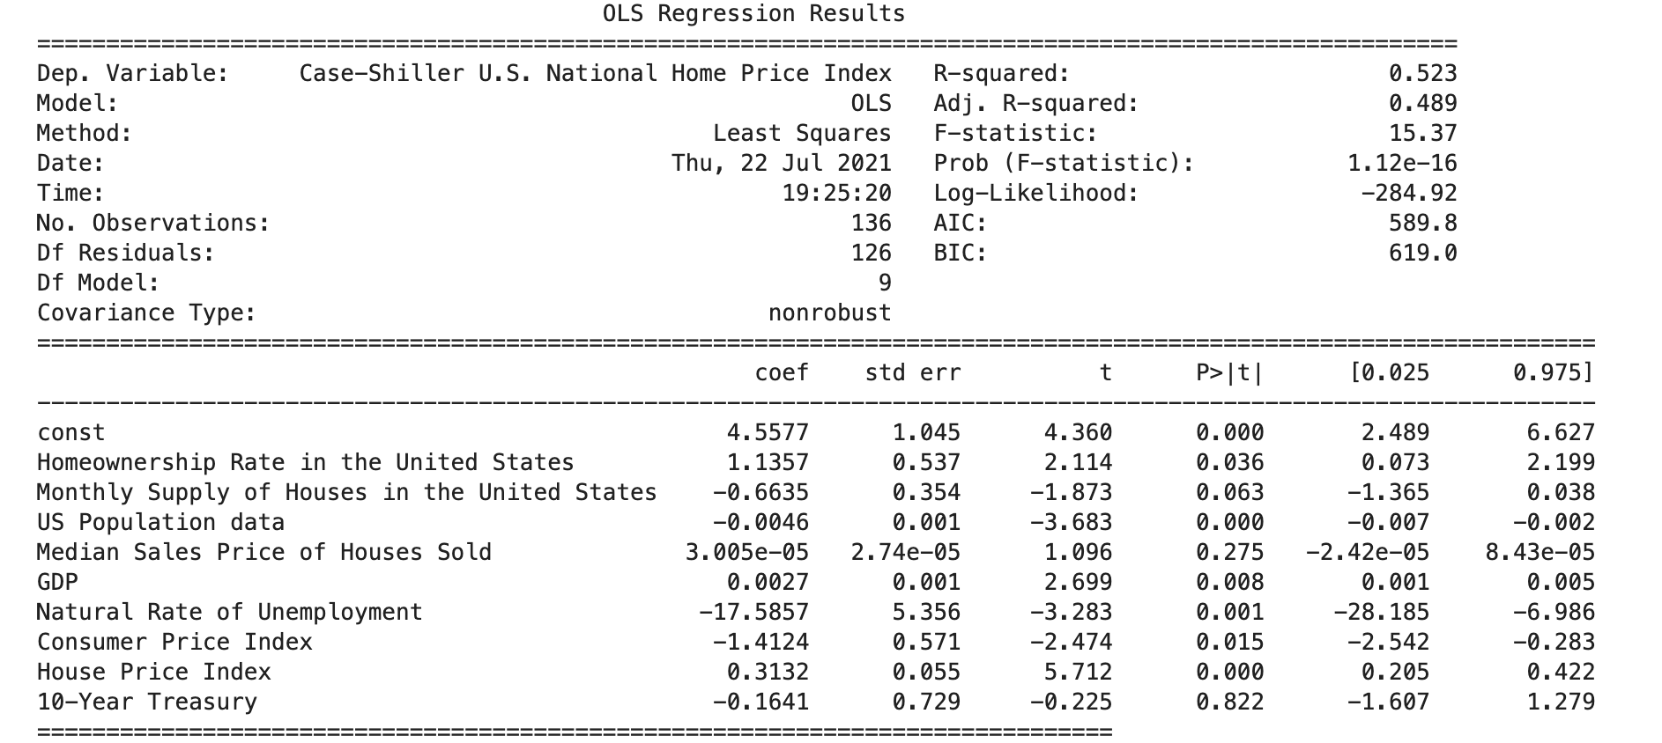
Linear Regression
A) Using Features as a Baseline
B) Using Lagged Returns as Baseline
Conclusion
Features as a Baseline provided a much higher r squared value
Speed & performance
Of concern was Median House Prices being insignificant at a p-value of 0.05

Slide 13
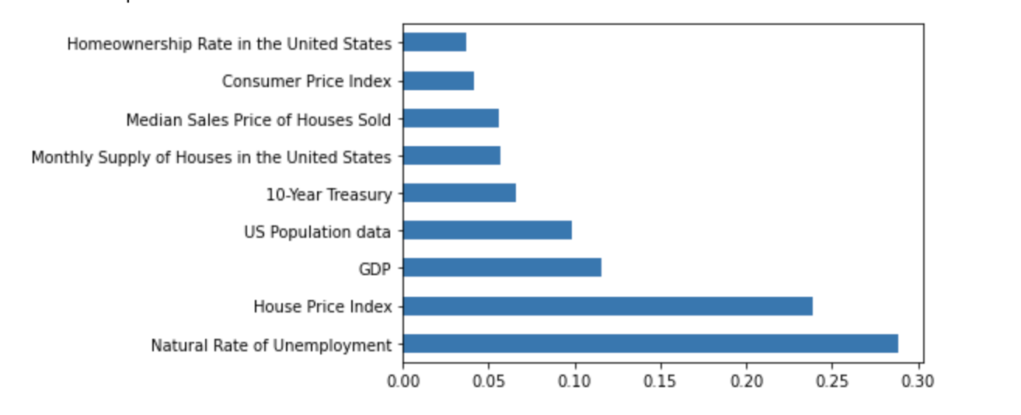
Random Forest Regressor
Look at feature importance
Noting model itself had low r squared score

Slide 14
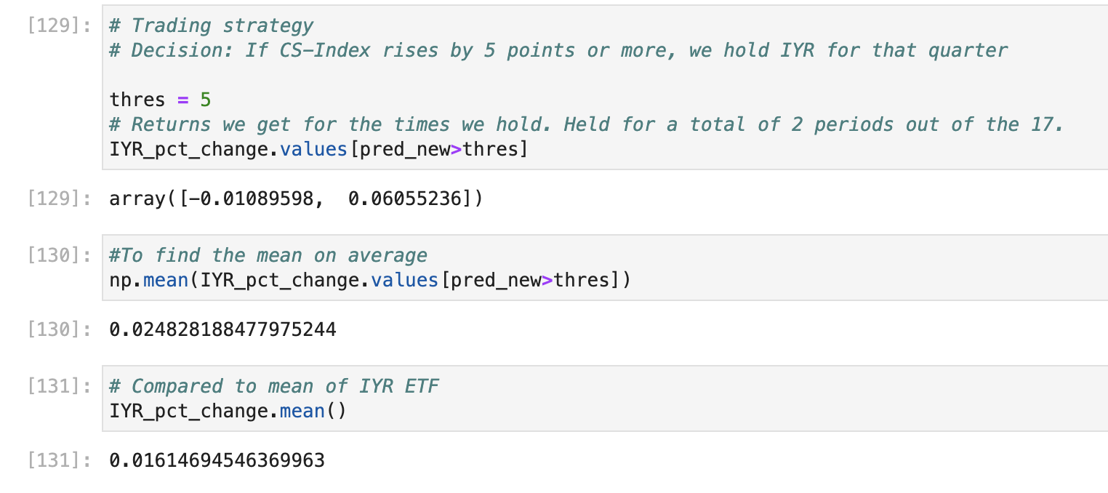
Linear Regression using train-test split
Used Alpaca API from 2013 - 2017
Predictions of CS-Index compared to actual percentage change of IYR
Set a trading strategy threshold
Model performed 8pp better, on average, than if hadn’t used model and followed IYR instead.

Slide 15


Linear Regression
Positive return

Slide 16


BOT LIVE DEMONSTRATION
Notes:
Now, my primary objective was to turn the dollar signs that was noticeably observable from JC and Liam into fruition by creating an operationable bot.
I initially ran my bot scripts on that which shall not be named, but after very good advice from a potential investor, we switched to PyCharm.
Also, gone are the days of trading out of a laptop in a bar. The future is here, invest in the big short trading bot.

Slide 17

SERIES A FUNDING
Extend model into daily basis
Host bot on EC2 Instance and generate money 4eva
Establish further parameters and features to strengthen our modelling
Notes:
The goal is to have a stronger model and eventually have it running without requiring our management of the trading bot.

Slide 18

Questions?

